Slide 1
Rescue - Robots

Slide 2
INFO6205 33906 Program Structure & Algorithms
Author : Vinoth Punniyamoorthy
NUID : 001225656
Section : 01

Slide 3
Problem statement
Identify the EXIT within a building / site during natural calamities or DURING EMERGENCY situation where no human intervention is not feasible.

Slide 4
Problem solution
Since the problem is concerned with mainly the human loss, the rescue operations should be carried out using Autonomous Robots.
A swarm robotics technique (PSO algorithm) can be utilized to identify the safe exit using a swarm of heterogeneous robots, the bots communicate with each other and change its position locally and giving a global solution towards a guided drone bot(Target).

Slide 5
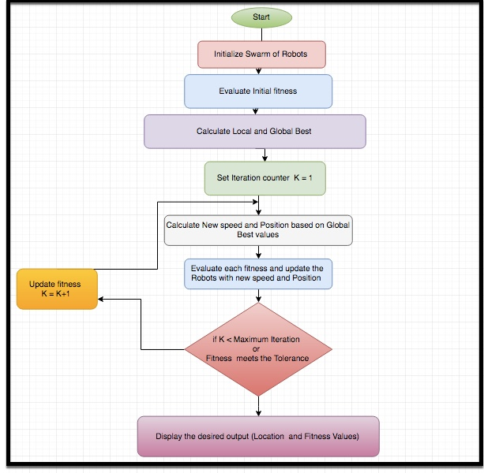
Object Model - Hierarchy Overview

Slide 6
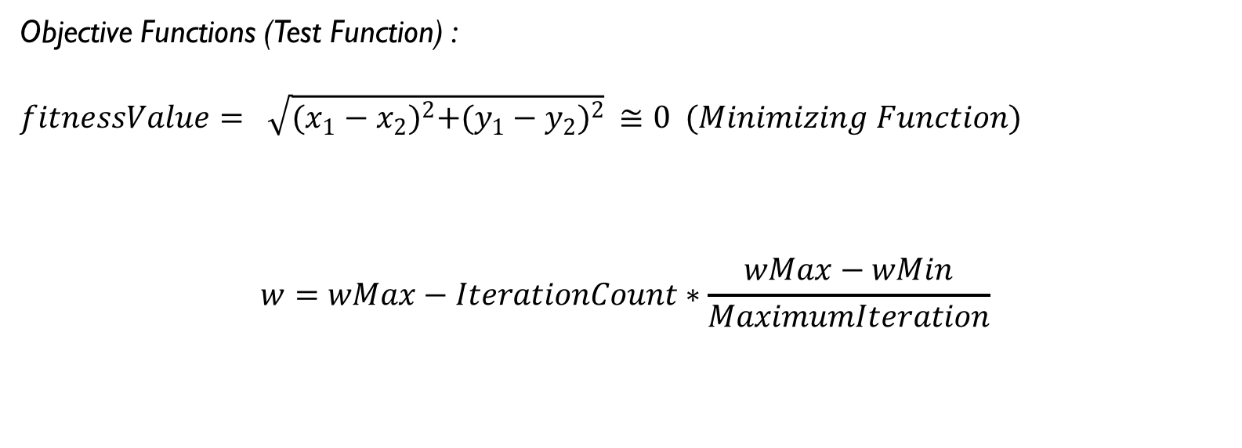
Key Computations
Objective Functions (Test Function) :
$fitnessValue= \sqrt{{(x_{1}−x_{2})}^{2}+{(y_{1}−y_{2})}^{2}} ≅0 (Minimizing Function)$
$$w=wMax−IterationCount∗\frac{wMax−wMin}{MaximumIteration}$$

Slide 7
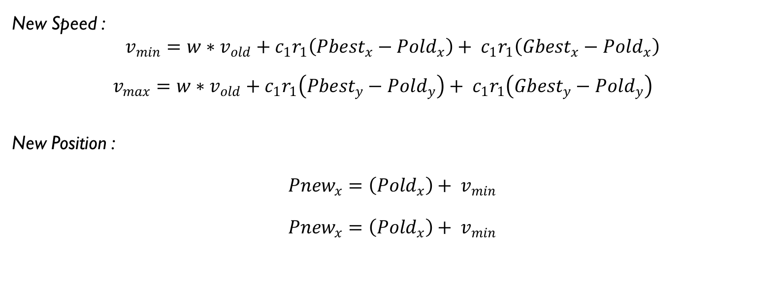
Key Computations CONT…
New Speed :
$$v_{min}=w∗v_{old}+c_{1}r_{1}\left({Pbest}_{x}−{Pold}_{x}\right)+ c_{1}r_{1}\left({Gbest}_{x}−{Pold}_{x}\right)$$
$v_{max}=w∗v_{old}+c_{1}r_{1}\left({Pbest}_{y}−{Pold}_{y}\right)+ c_{1}r_{1}\left({Gbest}_{y}−{Pold}_{y}\right)$
New Position :
$${Pnew}_{x}=\left({Pold}_{x}\right)+ v_{min}$$
$${Pnew}_{x}=\left({Pold}_{x}\right)+ v_{min}$$

Slide 8
Analysis

Slide 9


